Slide 1
Beyond Collaborative Filtering: The List Recommendation Problem
WWW’16
IBM Research & Microsoft

Slide 2
OUTLINE
INTRODUCTION
MOTIVATION
TWO-LAYERED SYSTEM
RESULTS
DISCUSSION

Slide 3
INTRODUCTION
Collaborative Filtering (CF) has satisfied results on isolated user-item tuples. However inter-item interactions have an effect on an recommendation list’s Click-Through Rate (CTR)
Instead of exploring problems such as implicit feedback, cold-start, rank optimization, this paper introduce a list recommendation problem, in which differently ordered lists get different click probability .

Slide 4
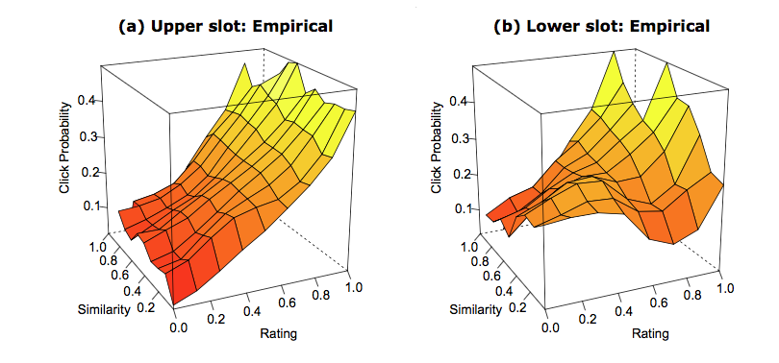
INTRODUCTION

Slide 5
MOTIVATION
Introduce the list recommendation problem.
Two-layered
collaborative filtering solutions (first layer)
find the optimal list(best CTR) to each user (second layer)
They consider all of factors jointly accounting for possible interactions, while prior approaches have considered some of these factors.

Slide 6
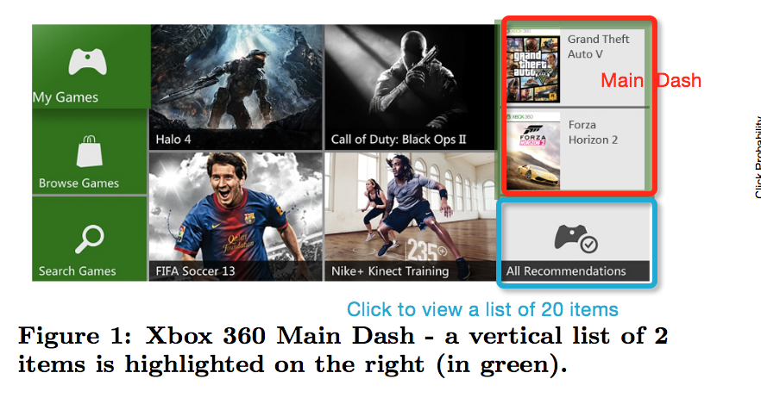
TWO-LAYERED SYSTEM
Scenarios
Two Xbox cases
Notes:
Main Dash
Forced to see, low CTR
Recommendation dash
Click to see, much higher CTR

Slide 7
TWO-LAYERED SYSTEM
Purchase data from Xbox users
One class CF(first layer)
First layer
User-item tuples
Other factors
Second layer
Impressions and clicks from two Xbox users
Gradient Boosted Trees (GBT)
Notes:
Xbox users几千万
Main dash balance(平衡人数)

Slide 8
TWO-LAYERED SYSTEM
Other factors
Inter-item Similarity Interactions
Item Fatigue
CTR Variations by Time of Day
Notes:
Similarity
产品的相似度，产品的雷同
Item Fatigue
用户看相同产品的疲劳度
不同时间段的点击率有区别
weekend和weekday

Slide 9
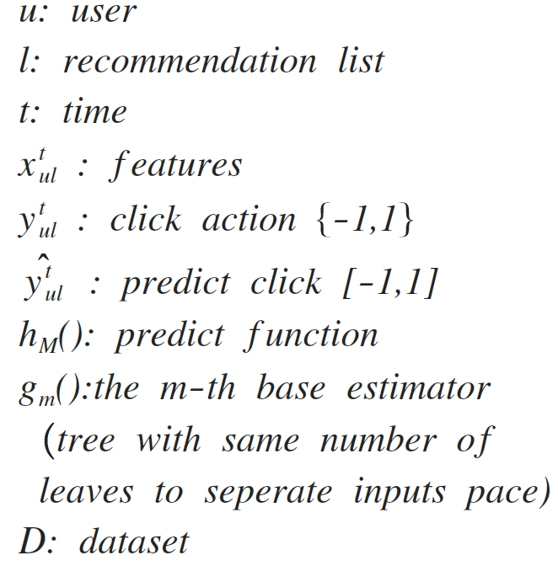
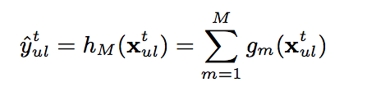
TWO-LAYERED SYSTEM
Gradient Boosted Trees They choose the GBT algorithm because it can easily detect and exploit these patterns without the need to carefully craft a kernel
Notes:
m相同结构的

Slide 10
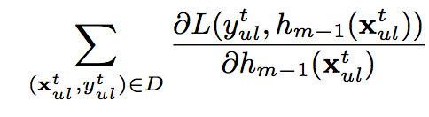
TWO-LAYERED SYSTEM
Gradient Boosted Trees pseudo-residual
L(y,f(x))=log(1+exp(-2yf(x)));

Slide 11
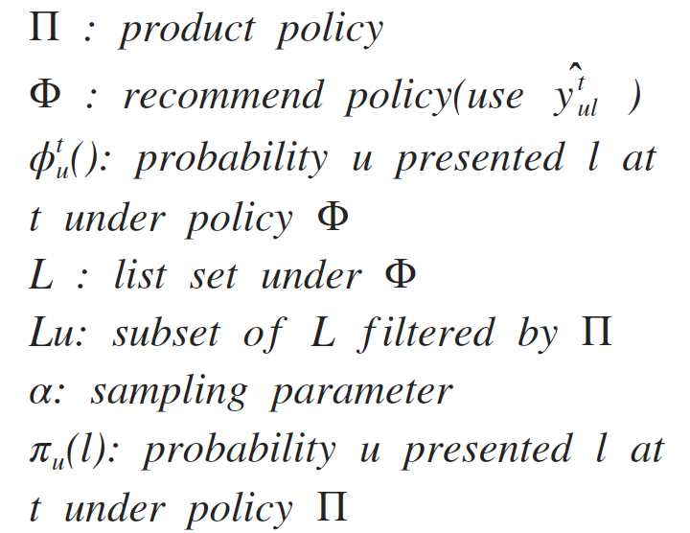
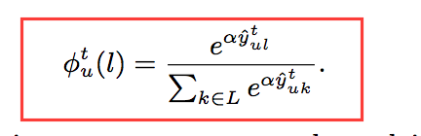
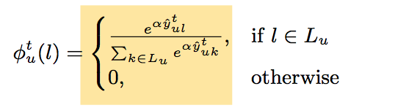
TWO-LAYERED SYSTEM
List recommendation policy

Slide 12
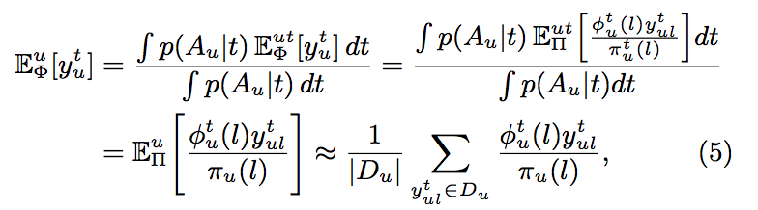
TWO-LAYERED SYSTEM
Gradient Boosted Trees- evaluation

Slide 13
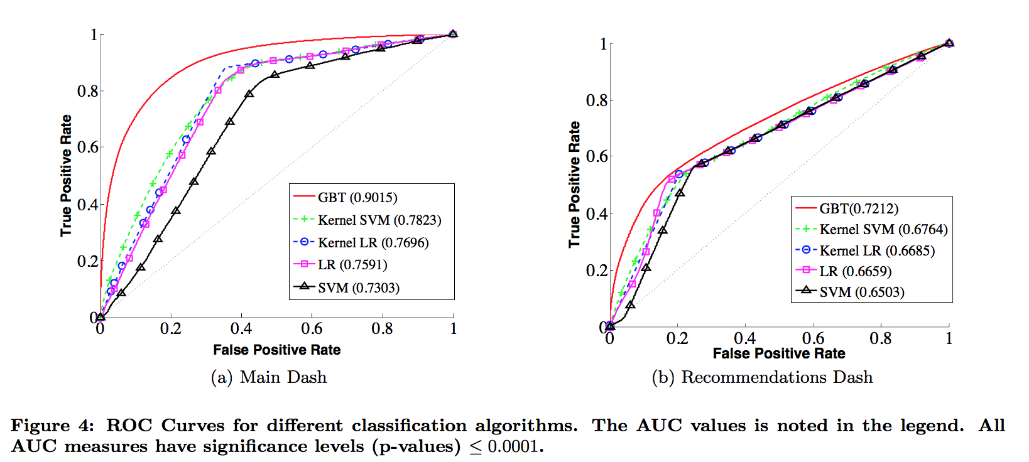
RESULT

Slide 14
RESULT
Additional Baselines
Equation 9 maximize the predicted ratings subject to constraints on the relevant features
Equation 10 maximizing the predicted ratings as well as a weighted sum of the features

Slide 15
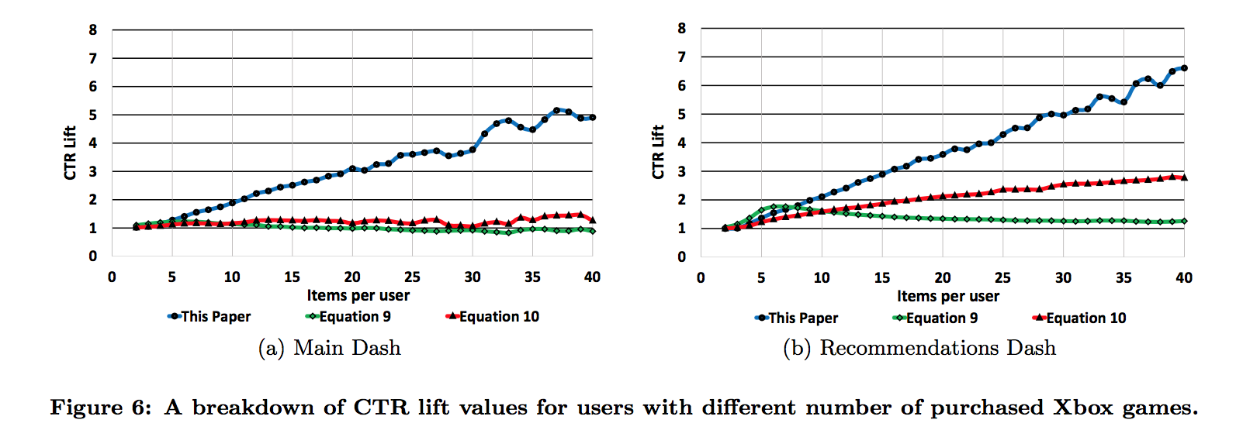

RESULT

Slide 16
DISCUSSION
在user-item 推荐已比较成熟的情况下 ，找到新的而且有实际价值的研究问题。(互换位置的影响情况)
两层系统的设计，利用了CF的预测结果，作为特征拿到second layer 来进行预测。
企业的优势，已有平台。迅速反馈实验结果。

